Slide 1
DOCKers
Muhammad Abeer Irfan

Slide 2
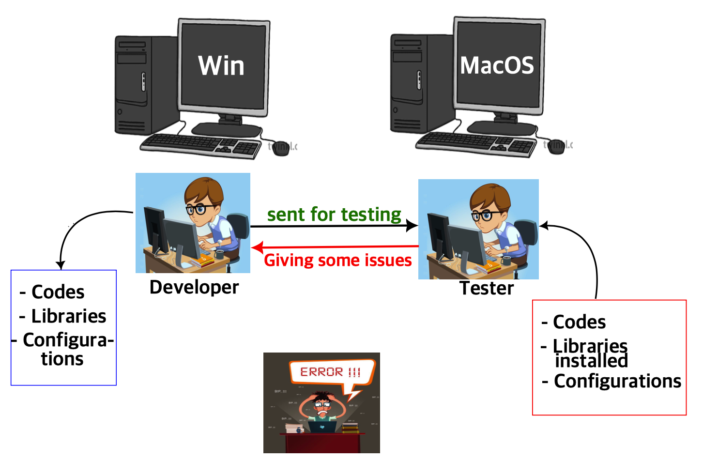

Pre-docker era
Docker?
Docker is an advanced version of virtualization or containerization.
It is also a type of deployment tool.

Slide 3
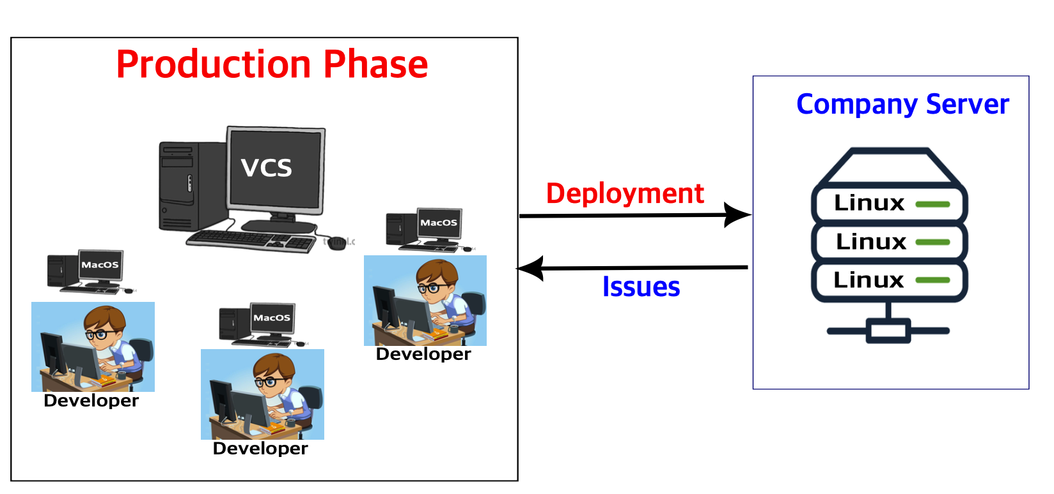
Pre-docker time

Slide 4
Docker Era

Slide 5
Docker Era
Successfully
deployed

Slide 6
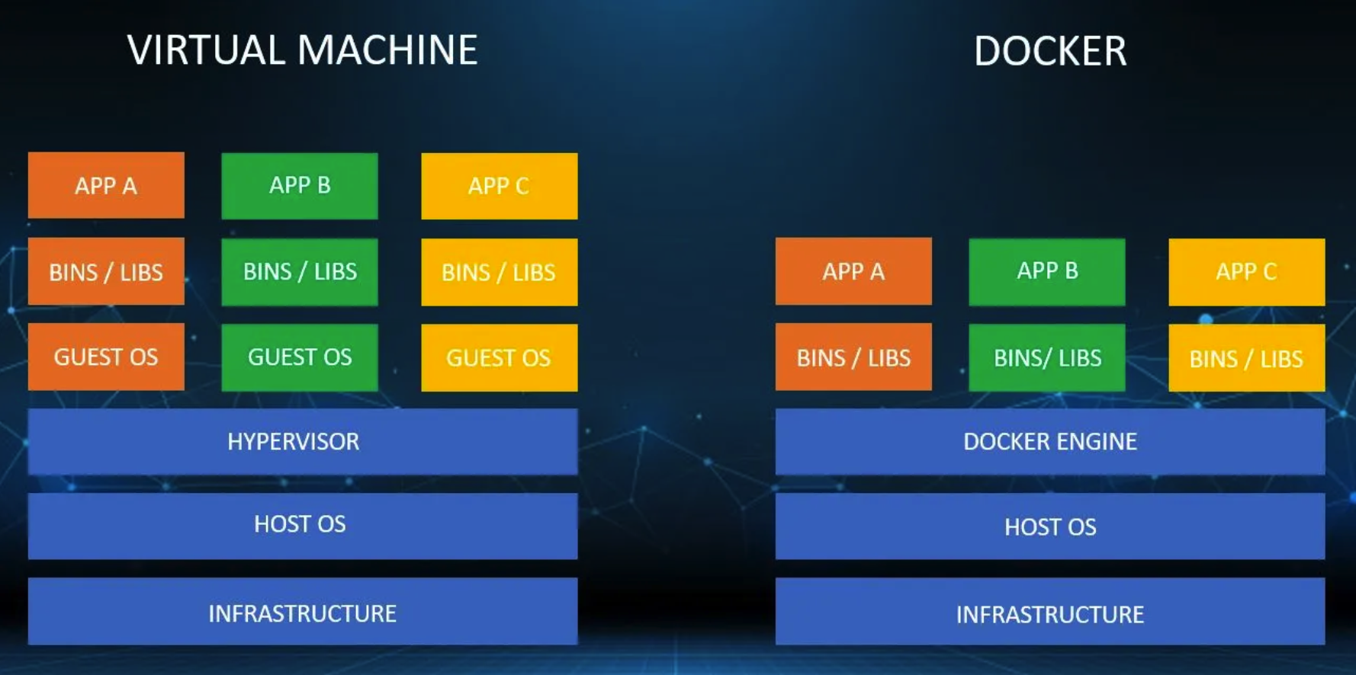
Docker vs Virtual Machine
Source: https://techieswiki.com/docker-vs-virtual-machine-what-are-the-key-differences.html

Slide 7
Docker
Docker is an open-source centralized platform designed to create, deploy and run applications.
Docker uses containers on the host OS to run applications.
Allows applications to use Linux kernel as a system rather than creating a whole Virtual OS.
Docker can be install on any OS but its engine runs on Linux distributions.

Slide 8
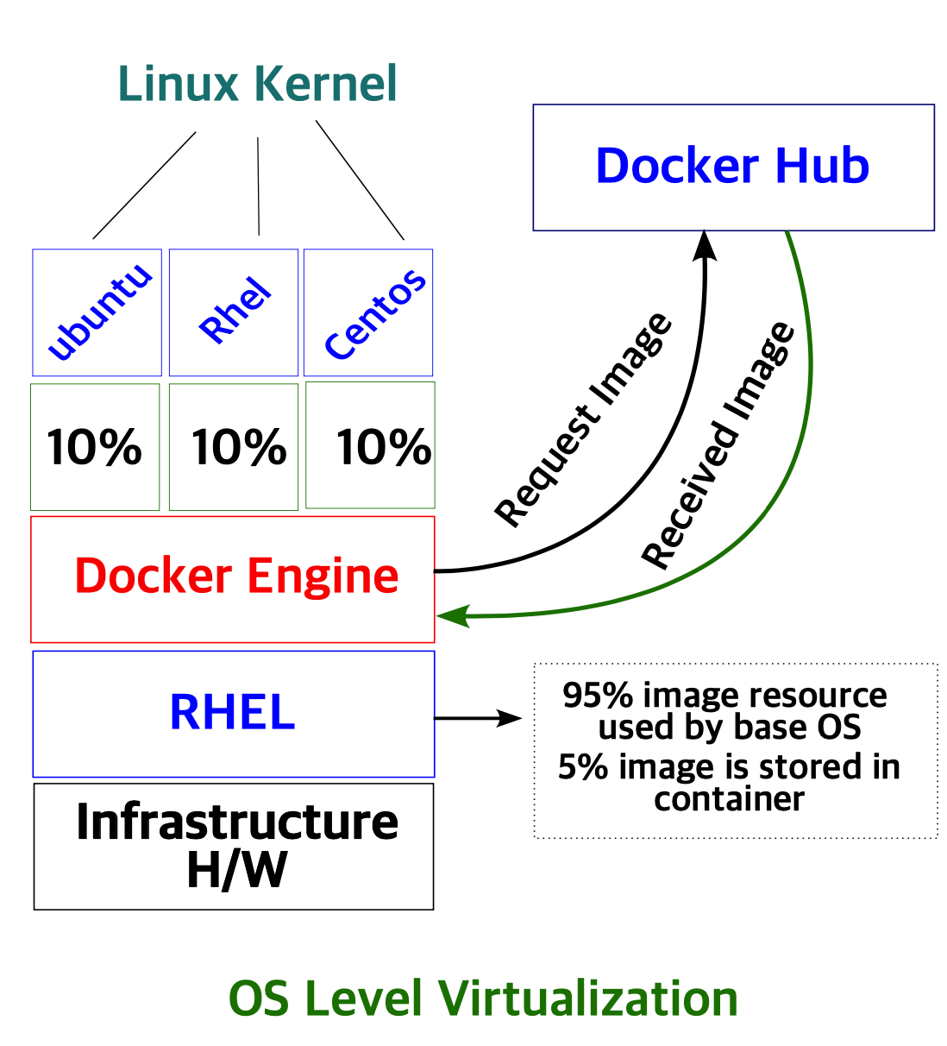
OS Level Virtualization

Slide 9
Advantages, Disadvantages of Dockers
Advantages of Docker | Disadvantages of Docker
1. Portability: Docker containers can run on any system, making it easy to move applications between environments. | 1. Complexity: Docker adds complexity, especially for users new to containerization. Learning curve required.
2. Isolation: Containers provide process and file system isolation, ensuring that applications don't interfere with each other. | 2. Resource Overhead: Docker containers can consume more resources compared to running applications directly on a host.
3. Efficiency: Containers are lightweight and start quickly, reducing the time and resources needed for deployment. | 3. Security Concerns: While Docker provides some security features, misconfigurations can expose vulnerabilities.
4. Scalability: Docker supports easy scaling of applications, allowing for efficient load balancing and resource allocation. | 4. Limited Windows Compatibility: Docker was initially designed for Linux, and Windows containerization has some limitations.
5. Version Control: Docker images are versioned, making it easy to roll back to previous states if issues arise. | 5. Not Ideal for Long-Running Services: Docker containers are better suited for stateless applications than long-running services.
6. Ecosystem: Docker has a vast ecosystem with a wealth of pre-built images and tools, reducing development time. | 6. Container Management: Managing a large number of containers can be challenging without orchestration tools like Kubernetes.
7. Easy Testing: Docker simplifies testing by providing a consistent environment for development, testing, and production. | 7. Learning Curve: Docker and containerization concepts may be challenging for some teams to grasp.

Slide 10
Architecture of Docker

Slide 11
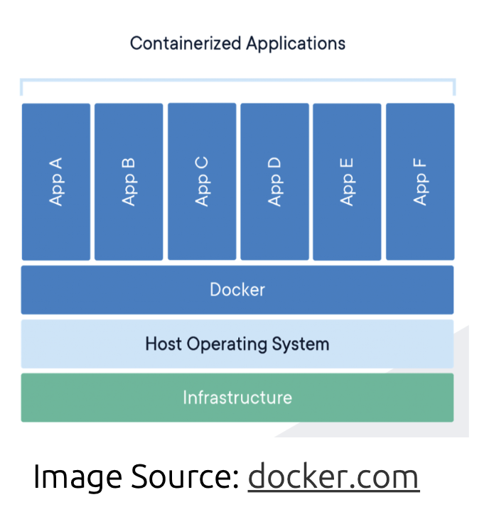
Docker containers
Standard unit of software
Packages code and dependencies
Can be shared as Docker Images
Multiple containers can be run simultaneously
Portable - Can be used with any OS
Lightweight - Uses the host operating system
Secure - Strong default isolation features
Sometimes used with VMs

Slide 12
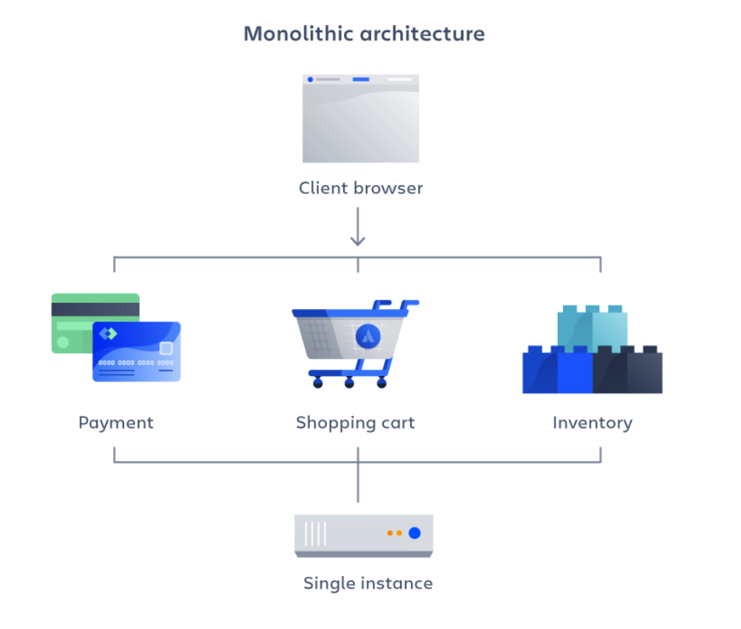
Monolithic architecture
A monolithic architecture is a traditional model of a software program, which is built as a unified unit that is self-contained and independent from other applications.
A monolithic architecture is a singular, large computing network with one code base that couples all of the business concerns together.
Source: https://www.atlassian.com

Slide 13
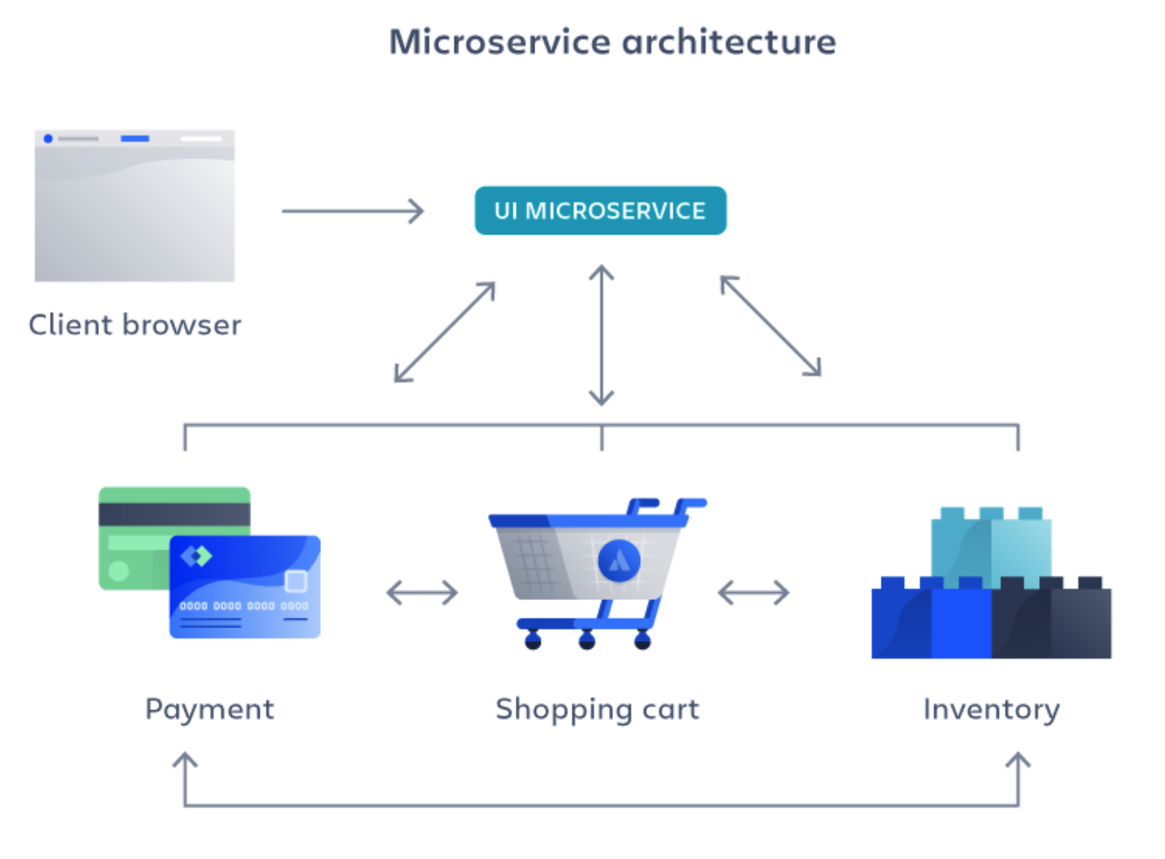
Microservice architecture
Microservices architecture, also simply known as microservices, is an architectural method that relies on a series of independently deployable services.
These services have their own business logic and database with a specific goal. Updating, testing, deployment, and scaling occur within each service.
Breaks large applications down into smaller executable components
Easy to maintain and test
Loosely coupled and can be deployed independently
Source: https://www.atlassian.com

Slide 14
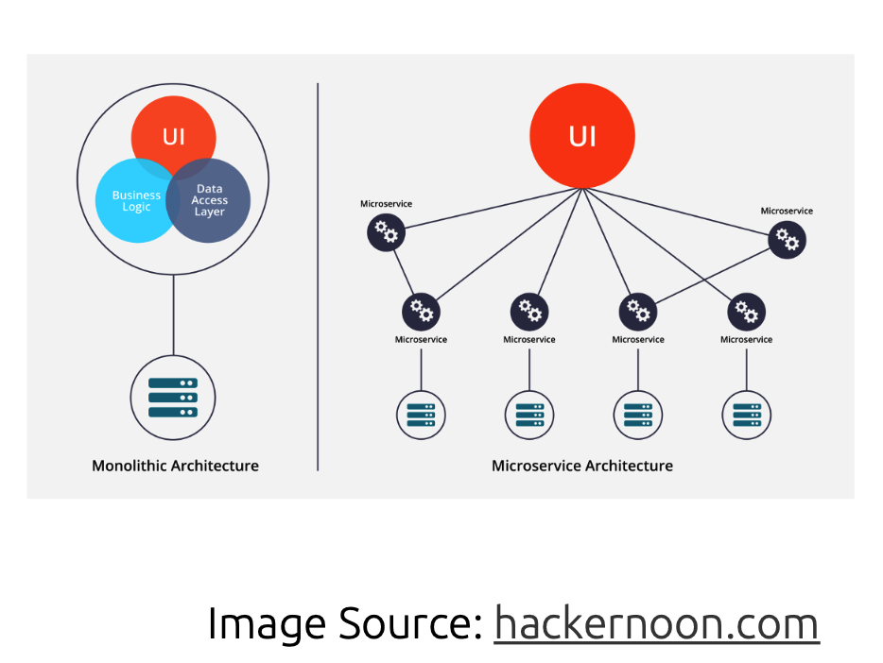
Monolithic vs micro server architecture

Slide 15
Advantages vs disadvantages
(Monolith)
Tightly coupled.
All the functionalities are dependent on each other, such as Scenario-I, if any of the service goes down e.g., categories whole. System will goes down.
Not so good at fault tolerance.
Works well with lesser traffic
Less modularity
Difficult to scale.
Create a new machine for some service and perform copy paste of machine – I.
(Microservice)
Loosly coupled.
Not dependent on each other
Good at fault tolerance
Works well in all the conditions of traffic
Higher modularity
Easy to scale.
Copy machine M2 and M3 to another machine.

Slide 16
Advantages vs disadvantages
Less complex
Lower cost ( cheaply build)
Low maintainability
Average programmers to build this architecture.
High complexity
Higher cost ( expensive to build)
High maintainability is required
Very skillful programmers are required to build this architecture.

Slide 17

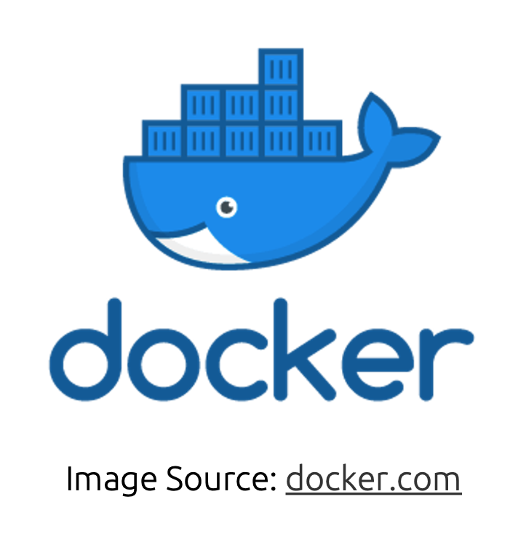

Why use docker?
Develop applications that work on any OS
Easy to share applications among teams
Easy to scale across multiple servers
Large applications can be broken into multiple
containers - one for each microservice
Great solution for Cloud Computing
Big community and library of Docker Images

Slide 18

Serverless
Removes Dependency on Infrastructure
Allows developers to focus on application development
Microservices can be decoupled with different cloud services
Usually more cost effective

Slide 19


Clicker quiz
Which of the following is an advantage of using Docker Containers over Virtual Machines?
a) Multiple containers can be run on the same machine
b) Uses the Host OS
c) Can be shared as images
d) all of the above

Slide 20

Clicker quiz
Which of the following is an advantage of using Docker Containers over Virtual Machines?
a) Multiple containers can be run on the same machine
b) Uses the Host OS
c) Can be shared as images
d) all of the above

Slide 21
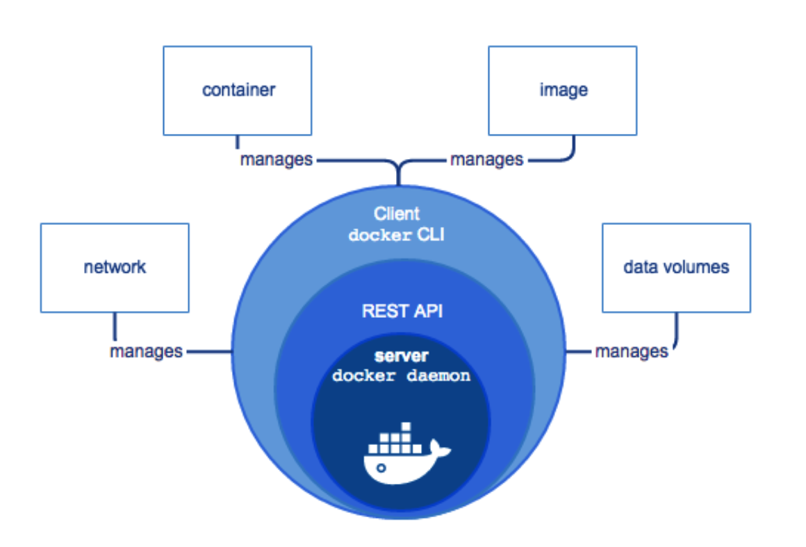
Install docker enginer
Install Docker Engine
• Docker Engine is available on a variety of Linux platforms, macOS and Windows 10 through Docker Desktop

Slide 22

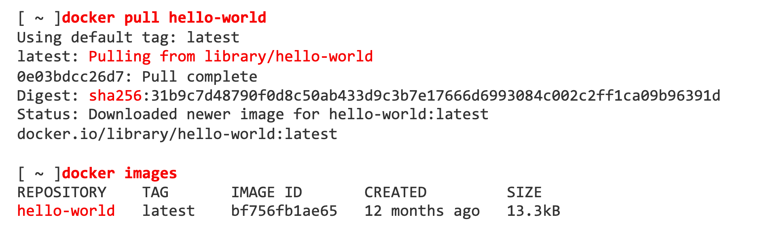
Pull an image
There are many publicly available images that we can use to work with Docker. The example below pulls a hello-world image using the docker pull command:

Slide 23
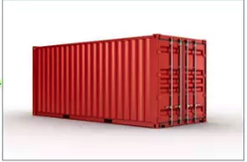
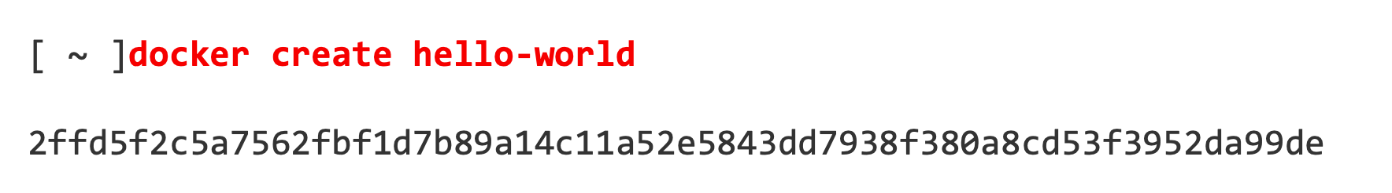
Create a container
To create a container from an image we can use the docker create command

Slide 24
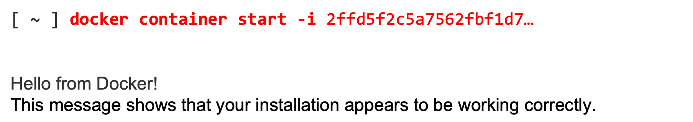
Run a container
To run a container, we can use the bitnami/postgresql command to start a container. The -i runs the container interactively and allows us to see the output

Slide 25

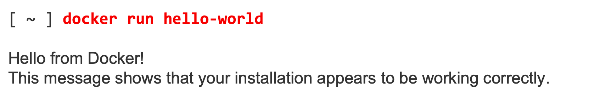
Run an image
There is a shortcut for building a container from an image and running it with the docker run command. This will create a new container for an image and run it:

Slide 26
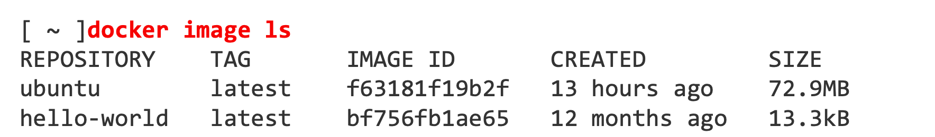
List images
To see what images are already installed on your machine you can use the docker image ls command. We can see our hello-world image below:

Slide 27
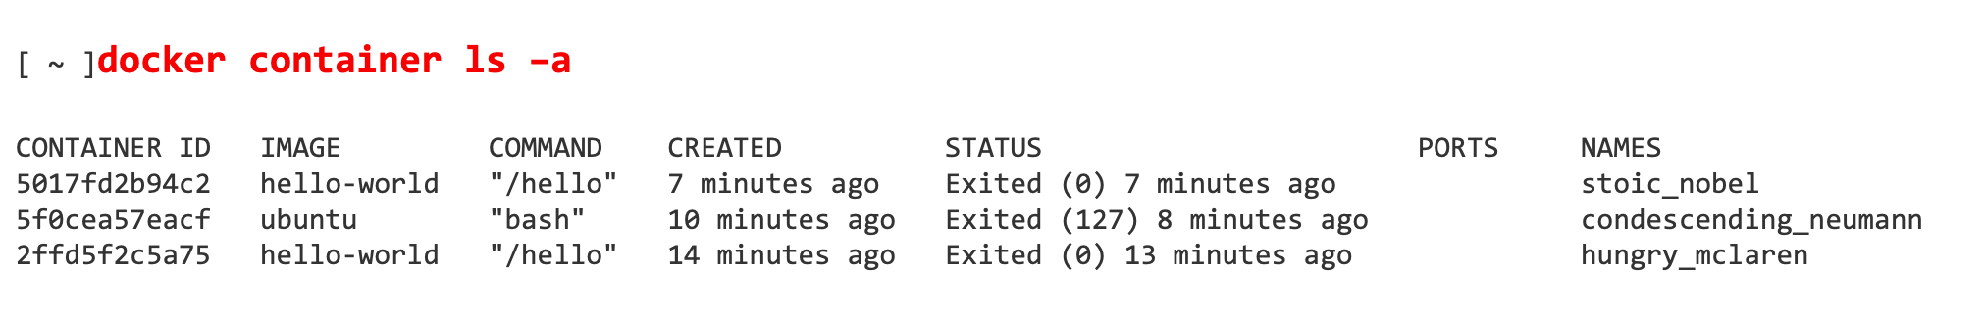
List of containers
To list the containers that we have built, we can use the docker container ls command. The -a flag allows us to see both stopped and running containers. There are two containers below, one that was built with the docker create command and the other that was built with docker run:

Slide 28
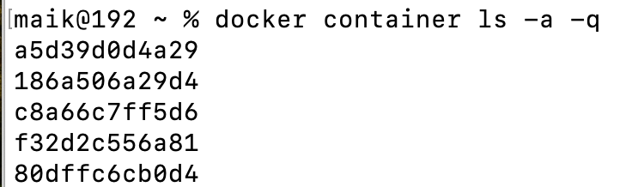
List of containers info only
To list the only containers information that we have built, we can use the docker container ls command. The -a flag allows us to see both stopped and running containers. -q There are various containers below:
[ ~ ] docker container ls –a –q
[ ~ ] docker ps ls –a –q

Slide 29
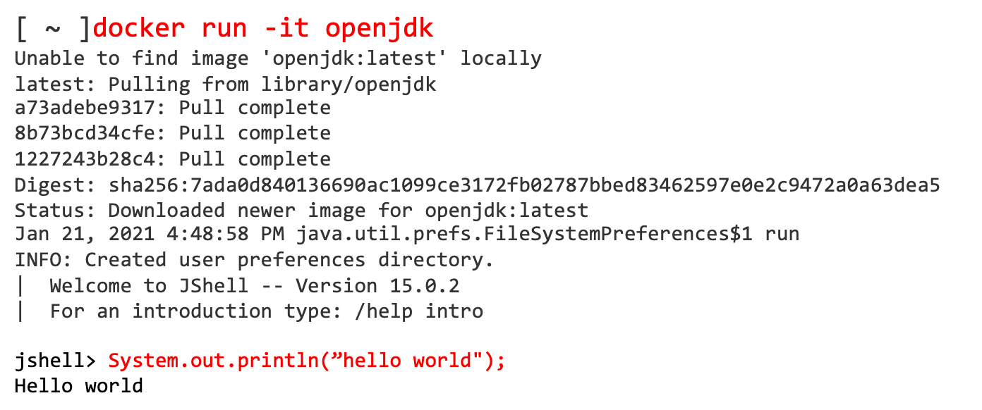
Running iteratively
Running containers interactively allows you to run commands inside the container if it supports it. We can use the openjdk image that we used before:
This allows us to execute java commands line by line in a Java shell

Slide 30
List running processes
To see what containers are currently running, we can use the docker ps command. This is useful when you are running containers in the background.

Slide 31
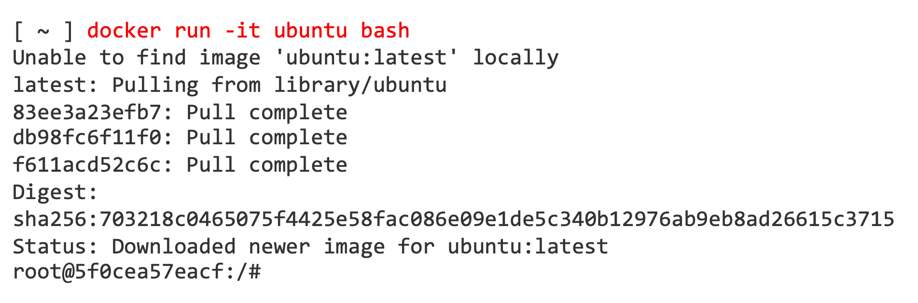
Interactive shell

Slide 32

Clicker quiz
How can you run a container?
docker container start [ContainerID]
docker run [ContainerID]
docker run [ImageID]
none of the above

Slide 33
Clicker quiz
How can you run a container?
docker container start [ContainerID]
docker run [ContainerID]
docker run [ImageID]
none of the above

Slide 34
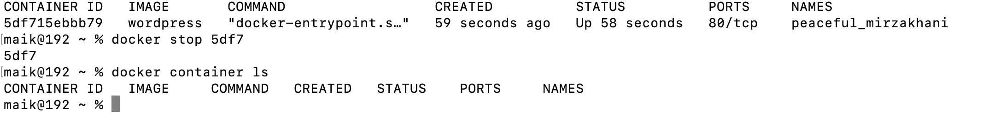
Stop container
To stop a container that is running, we can use the docker stop ContainerID command.
[ ~ ] docker stop -it ubuntu bash

Slide 35
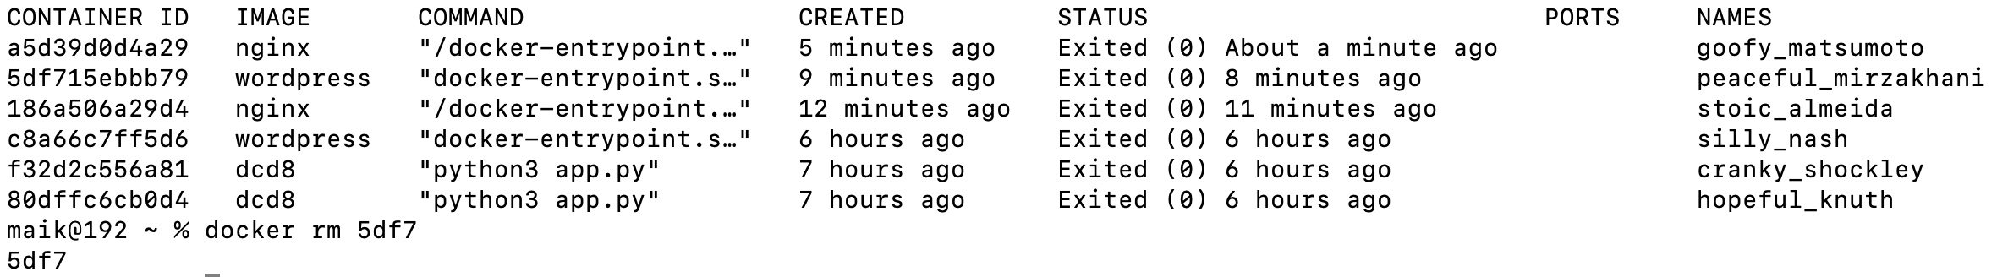
Removing container
To remove a container from the existing containers, we can use the docker rm ContainerID command.
[ ~ ] docker rm containerID

Slide 36
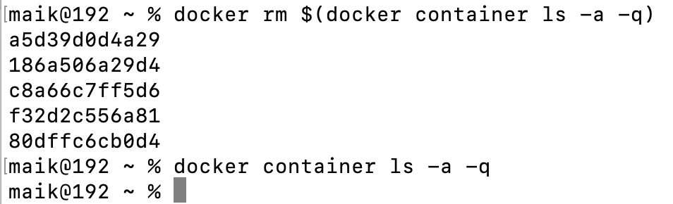
Removing multiple containers
If we have many containers running, will it be suitable to remove all one by one?
Off course Not ☺
We can use docker rm ls –a -q command.
[ ~ ] docker rm ls –a –q

Slide 37
Container name
You will find random names of the containers once created, highlighted in the red box in the figure below:
If we want to assign our own name to the container, we can use the docker run –name imagename –P imagename:version command.
[ ~ ] docker rm ls –a –q

Slide 38
Port mapping
If we want to run an application on some specific port number, then we can use the docker run –p desired port#: default port# imagename command
[ ~ ] docker run –name mywordpress –p 9000:8080 –d wordpress:latest

Slide 39
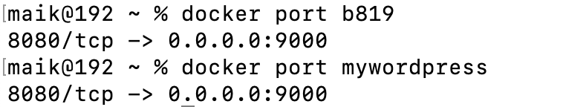
Port number
If we want to check the port number on which our application is currently running, we can use docker port containerID/imagename command:
[ ~ ] docker port mywordpress

Slide 40
Get into container
To get into the running container, we can use docker exec –it containerID bash command:
[ ~ ] docker exec –it 46fe bash

